Slide 1






AI & EMERGING TECHNOLOGIES
Engineering the Future
TEAM MEMBERS
NAVEEN PRAKASH • ANCHAL KUMAR • ABHISHEK RAJ • PRATEEK KASHYAP
AI & EMERGING TECHNOLOGIES
ENGINEERS' DAY 2026

Slide 2




01 THE BIG IDEA
Artificial Intelligence is changing engineering from systems that simply follow instructions to systems that can learn, predict and assist decisions.
The opportunity is not only to use AI — it is to engineer reliable solutions around it.
AI & EMERGING TECHNOLOGIES
01 / THE BIG IDEA

Slide 3








02 WHAT COUNTS AS EMERGING TECH?
GENERATIVE AI
AI AGENTS
ROBOTICS
Creates text, images, synthetic code, and design prototypes autonomously.
Intelligent software systems that plan and perform complex multi-step tasks.
Intelligent physical machines that sense environments and act precisely.
EDGE AI
IoT + AI
High-speed intelligence running locally close to the device on microprocessors.
Networks of connected smart sensors turning raw telemetry into predictive, intelligent systems.
AI & EMERGING TECHNOLOGIES
02 / EMERGING TECHNOLOGIES

Slide 4
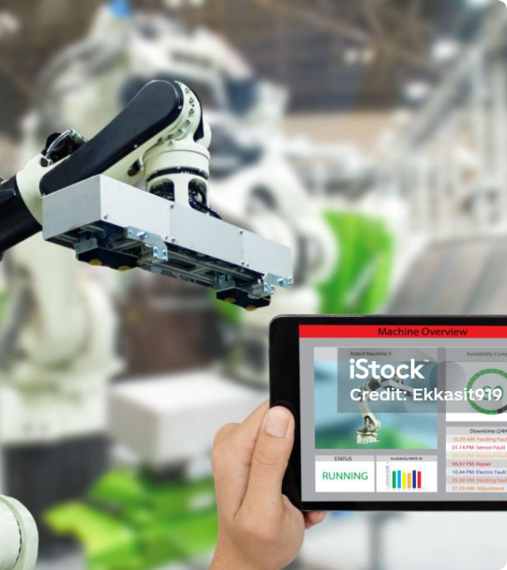







03 DATA TO INTELLIGENCE
Smart Factory Example
A smart factory monitors machines continuously. AI detects an unusual vibration pattern, predicts a possible failure, and alerts maintenance before production stops.
This is the paradigm shift from reactive engineering to predictive engineering.
AI & EMERGING TECHNOLOGIES
03 / DATA TO INTELLIGENCE

Slide 5
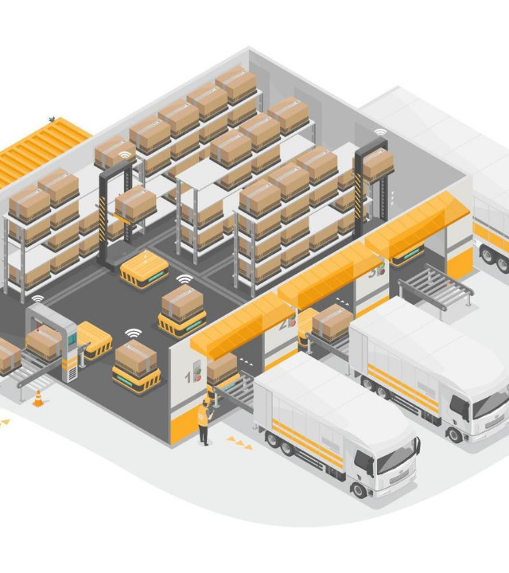
04 AI + IOT + ROBOTICS
Imagine an autonomous smart warehouse where:
IoT Sensors: Track inventory and environmental conditions in real-time
AI Algorithms: Predict demand fluctuations and optimize logistics routes
Autonomous Robots: Move goods seamlessly across the floor
Edge AI: Enables ultra-fast local decision making on site
Human Supervision: Oversees system exceptions and safety protocols
Together, these technologies create an integrated intelligent ecosystem.
AI & EMERGING TECHNOLOGIES
04 / AI + IOT + ROBOTICS

Slide 6

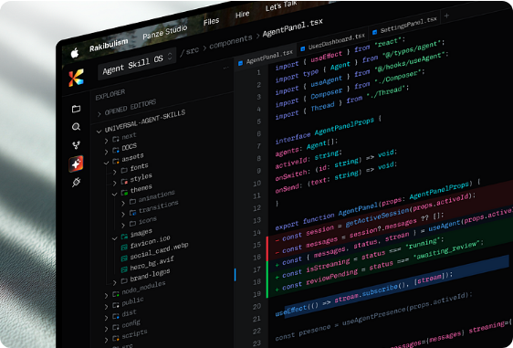
05 GENERATIVE AI: THE NEW ASSISTANT
Generative AI helps engineers accelerate innovation:
Generate and explain complex code
Summarize dense technical information
Explore novel design alternatives
Create documentation and rapid prototypes
Interact with complex data using natural language
Human verification remains essential for accuracy, safety and accountability.
AI & EMERGING TECHNOLOGIES
05 / GENERATIVE AI ASSISTANT

Slide 7



06 REAL-WORLD IMPACT
HEALTHCARE
MANUFACTURING
AGRICULTURE
Medical image assistance & clinical workflow optimization.
Predictive maintenance & automated quality inspection.
Crop monitoring, soil analysis & precision farming.
CYBERSECURITY
EDUCATION
SMART CITIES
Anomaly detection & real-time threat detection.
Personalized learning support & skill adaptation.
Traffic, energy grids & resource optimization.
AI & EMERGING TECHNOLOGIES
06 / REAL-WORLD IMPACT

Slide 8

07 ENTREPRENEURIAL OPPORTUNITY
AI is creating new startup opportunities because software can now automate tasks that previously required large teams.
A strong AI startup should solve a real problem, not simply add an “AI” label.
VALUE
AI & EMERGING TECHNOLOGIES
07 / ENTREPRENEURIAL OPPORTUNITY

Slide 9


08 RISKS & RESPONSIBILITY
AI CAN CREATE VALUE — AND ALSO NEW RISKS:
BIAS: Unfair or skewed algorithmic outcomes
PRIVACY: Misuse or breach of personal data
SECURITY: AI-enabled cyber attacks
MISINFORMATION: Deepfakes & synthetic content
HALLUCINATION: Confident but incorrect outputs
Responsible engineering means testing, monitoring, transparency, and human oversight.
AI & EMERGING TECHNOLOGIES
08 / RISKS & RESPONSIBILITY

Slide 10








09 INDIA'S OPPORTUNITY
India can use emerging technologies to build solutions at population scale:
Indian-Language AI
Digital Infrastructure
Smart Manufacturing
Multilingual models breaking communication barriers.
Integrating AI into public scale digital platforms.
Next-generation industry 4.0 production hubs.
Affordable Healthcare
Skilling & Tech
Agri & Climate-Tech
AI-powered diagnostics accessible everywhere.
AI-driven education and global engineering products.
Sustainable technology for climate resilience.
AI & EMERGING TECHNOLOGIES
09 / INDIA'S OPPORTUNITY

Slide 11



10 THE ENGINEER OF THE FUTURE
Core Pillar Combination
TECHNICAL SKILLS + DOMAIN KNOWLEDGE + CREATIVITY + ETHICS
The Shift in Advantage
The competitive advantage will shift from "knowing everything" to asking better questions, validating answers, and building better systems.
"Learn to work with AI, not fear it."
AI & EMERGING TECHNOLOGIES
10 / ENGINEER OF THE FUTURE

Slide 12
CONCLUSION
DON'T JUST PREDICT THE FUTURE.
ENGINEER IT.
AI and emerging technologies give engineers extraordinary tools. Our responsibility is to turn those tools into systems that are useful, secure, sustainable, and human-centered.
Thank You
AI & EMERGING TECHNOLOGIES
ENGINEERS' DAY 2026

Slide 13





Image Sources
https://asset.gecdesigns.com/img/wallpapers/futuristic-technology-desktop-wallpaper-with-glowing-neural-network-and-digital-circuit-flow-sr24022606-cover.webp
Source: gecdesigns.com
https://media.istockphoto.com/id/905416756/photo/iot-industry-4-0-concept-industrial-engineer-using-software-in-tablet-to-monitoring-machine-in.jpg?s=1024x1024&w=is&k=20&c=-DM1nDWL3b7ZLTNfiu77sue9OnMl2qCnI-El5VjIVTU=
Source: www.istockphoto.com
https://panrobotics.vn/Data/Sites/6/media/content/smart-warehouse/smart-warehouse-yellow-heavy-cargo-robot-carry-for-iot-shipping-and-business-system-or-big-logistics-smart-factory-isometric-isolate-vector.jpg
Source: panrobotics.vn
https://cdn.dribbble.com/userupload/47992331/file/da7142f09c2bfa4632c1cd6ab2a4b60c.png?resize=752x&vertical=center
Source: dribbble.com
https://img.magnific.com/free-photo/cybersecurity-data-protection-digital-lock-future_23-2151997014.jpg?semt=ais_hybrid&w=740&q=80
Source: www.magnific.com

